Slide 1
A Leader-Follower Game-Based Life Cycle Optimization Framework and Shale Gas Supply Chain Application
Jiyao Gao and Fengqi You
Notes:
Hi, everyone, this is Jiyao. it is my great honor to give you this presentation. Today I am going to introduce you a leader-follower… This work is co-authored with prof. You at Cornell university.

Slide 2



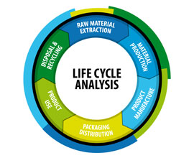
Motivation
PAST
Cost-efficiency or profitability is the only driver of supply chain optimization
Now
Multiple metrics (GHG emission, energy efficiency, social impacts, etc.) are applied as important indicators of a system’s overall performance
Life cycle optimization (LCO) framework
Life Cycle Assessment
Multiobjective Optimization
Notes:
In recent years, people are more and more concerned about sustainability. Therefore, instead of taking economic performance as the only indicator in the supply chain optimization. Multiple metrics, such as GHG emission, energy efficiency, social impacts, etc. have been applied in addition to the economic ones. Based on this, the life cycle optimization approach is proposed and widely used.

Slide 3







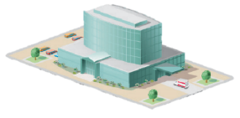

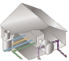
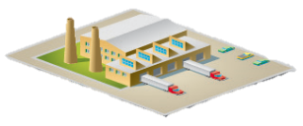

Motivation
Centralized Model
A single decision maker has full control
All the decisions can be implemented successfully
Full Control
Suppliers
Manufacturers
Customers
Notes:
However, until now most of the current supply chain optimization work still rely on centralized models. All the life cycle optimization research is viewing the system from a single-player perspective. which means an aggregated leader is assumed. This single leader has full control of the whole supply chain, and as a result, all the decisions made by the decision maker can be perfectly implemented.

Slide 4




Motivation
Decentralized Model
Multiple players pursue different objectives
Solutions from centralized model can be infeasible
Suppliers
Manufacturers
Customers
OR
Notes:
No one can deny the fact that the centralized model has made great contribution to the supply chain optimization. However, the ideal assumption made in the centralized model is not what we should rely on and can be problematic. In practice, a supply chain is normally managed by multiple players. Each of them may pursue different objectives. This easily results in a non-cooperative system. As a consequence, the optimal solutions obtained from the centralized model can be infeasible. To address this drawback of the classical centralized model, the leader-follower game theory is an useful tool.

Slide 5


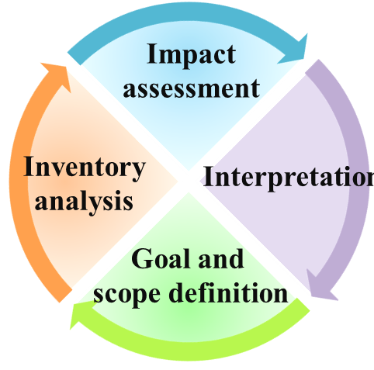
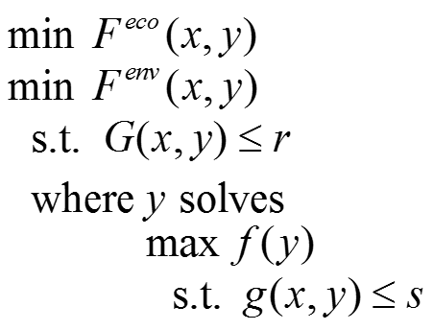
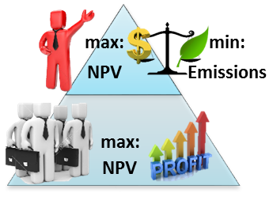
Life Cycle Optimization for Non-Cooperative SCs
The Decision-Maker
Only controls part of the supply chain
Multi-objective life cycle optimization
Try its best for sustainable supply chains
Considers multiple sustainability metrics
Other Stakeholders
Economic optimization (cost-efficiency or profitability) for supply chain units under its control
Game Theory
Life Cycle Optimization

Slide 6


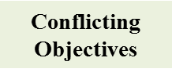


Novel Framework
Leader’s Problem
Multi-Objective MIBLP Problem
Pursuing
Leader acts first
Follower’s Problem
Pursuing
Follower reacts rationally
Notes:
Here I use this figure to show how this novel modelling framework works. First of all, following the Stackelberg game the players in this supply chain are classified as one leader and one follower. The leader has the information advantage and enjoys the priority to make decisions first. In return, it is the leader’s responsibility to lead the supply chain to a sustainable direction. Therefore, we consider both the economic and environmental objectives for the leader. After the leader’s decisions are observed, the follower will react rationally to pursue its own profit. The conflicting objectives between different criteria and players can be addressed by integrating the leader-follower game theory with life cycle optimization approach, and the resulting problem is a multiobjective MIBLP problem.

Slide 7

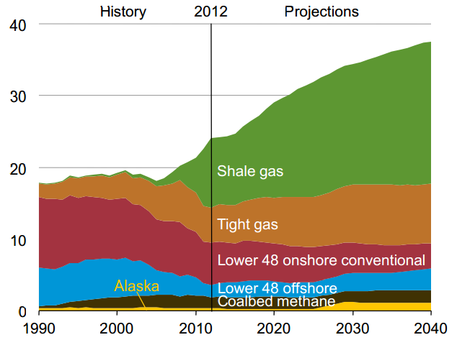
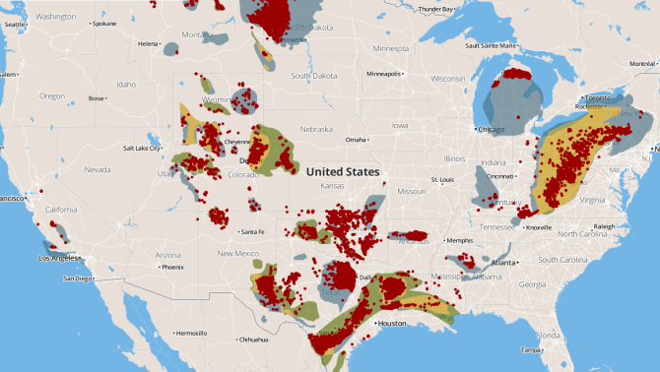
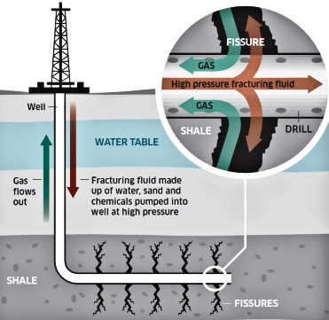
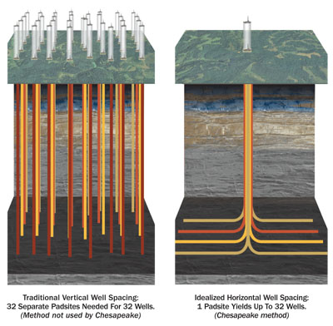
Application: Shale Gas
Unconventional natural gas from shale rock
Provides 20~40% energy needs in the U.S.
Large-scale production to due to hydraulic fracturing and horizontal drilling
Over 63,000 shale wells in the U.S.
Hydraulic fracturing
Horizontal drilling
U.S. natural gas production
Notes:
First is the motivation of our research. As we all know, natural gas as one of the major energy sources, has the following characters: First, It’s very clean. It has very high energy content, efficient burning property and lower emissions such as CO2 Sox and Nox. Second, it’s very cheap, the average price is around $4~5 per million BTU. Third, it has such a large reservation over the world, that in the U.S. 47.8 trillion cubic meters of natural gas has been explored, rank 5 in the world. Countries like China and Russia also have very large reservations. As to shale gas, we know it’s the unconventional natural gas extracted from shale rock, and it has a long history that the first shale gas production dates back to 1821 in New York. Most importantly, right now about 20% of the energy needs are satisfied by natural gas, and this number is predicted to be 40% in the future. Meanwhile, around 40% natural gas come from shale.

Slide 8
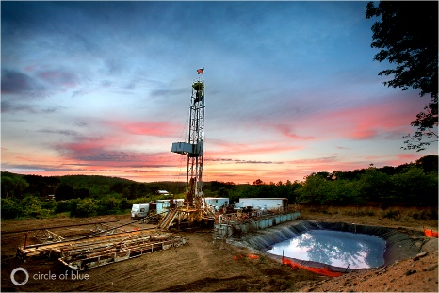
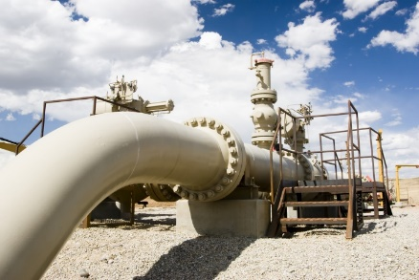
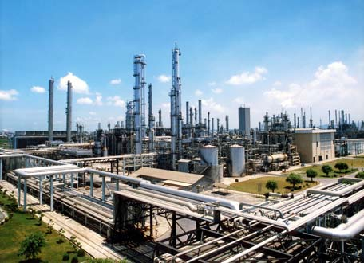
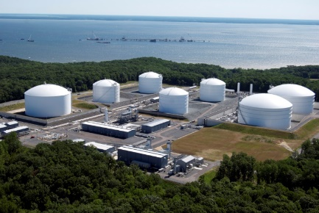
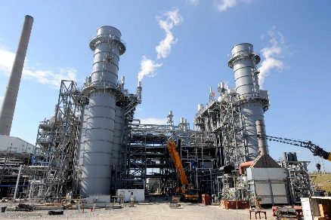
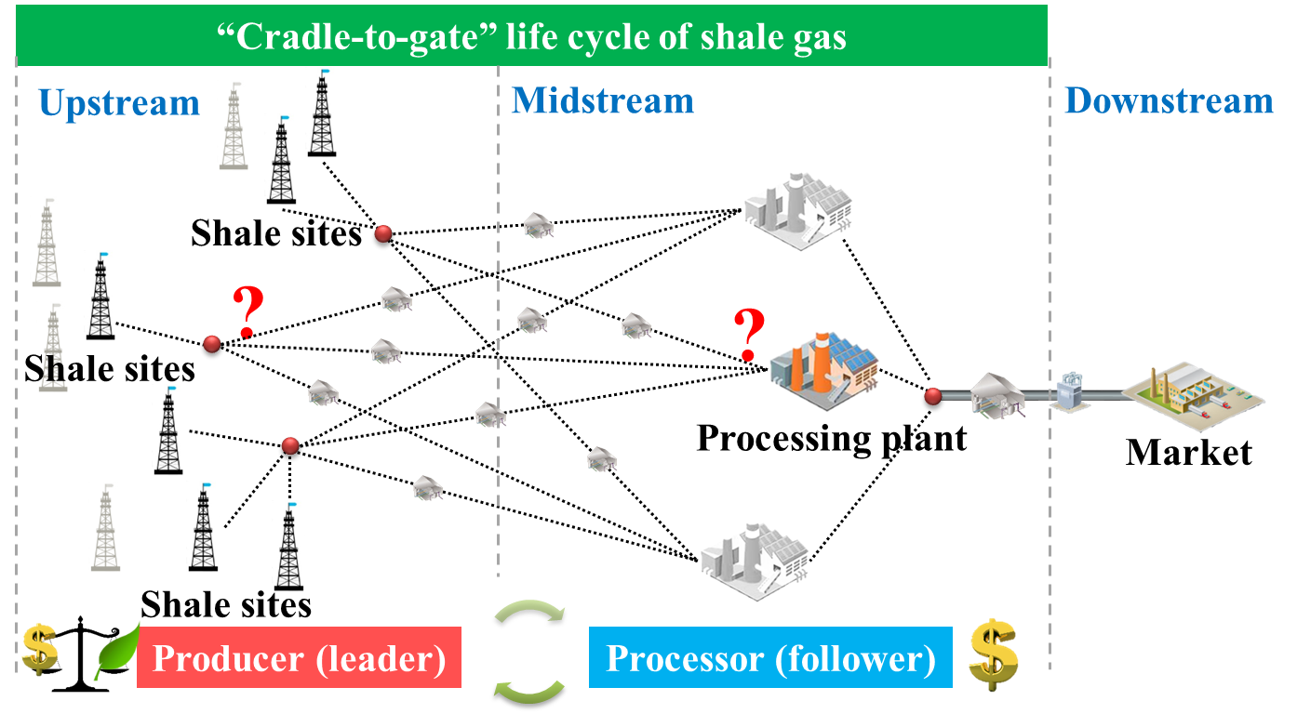
Shale Gas Supply Chain
Notes:
As mentioned, we consider the shale gas supply chain as an application of the proposed modeling framework, where the upstream producer/operator, as the player who initiates the supply chain, is identified as the leader. The midstream processor, as the processing service provider, is identified as the follower. We focus on the production phase of shale gas, which covers the cradle-to-gate life cycle of shale gas.

Slide 9


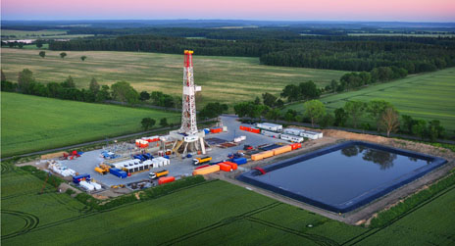
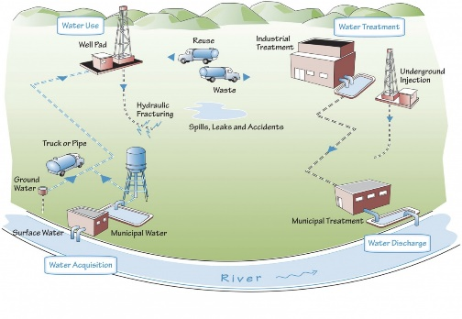


Problem Statement: Leader’s Problem
Given
Feedstock availability, demand
Candidate sites
Technology options
Unit cost and emission data
……
Determine
Procurement plan
Selection of technology
Production profile
Transportation flow
Objectives
Max: Leader’s profit
Min: Life cycle environmental impacts
Full information of the supply chain, including the possible reaction of the follower(s)
Decisions that may directly affect the feasible region of follower’s problem
vs.
Notes:
Next, to illustrate the propose modelling framework, we present a case study based on Marcellus shale gas supply chain. The leader’s problem is as follows.

Slide 10
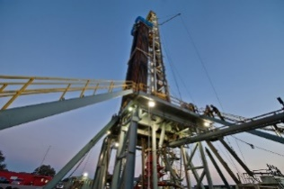
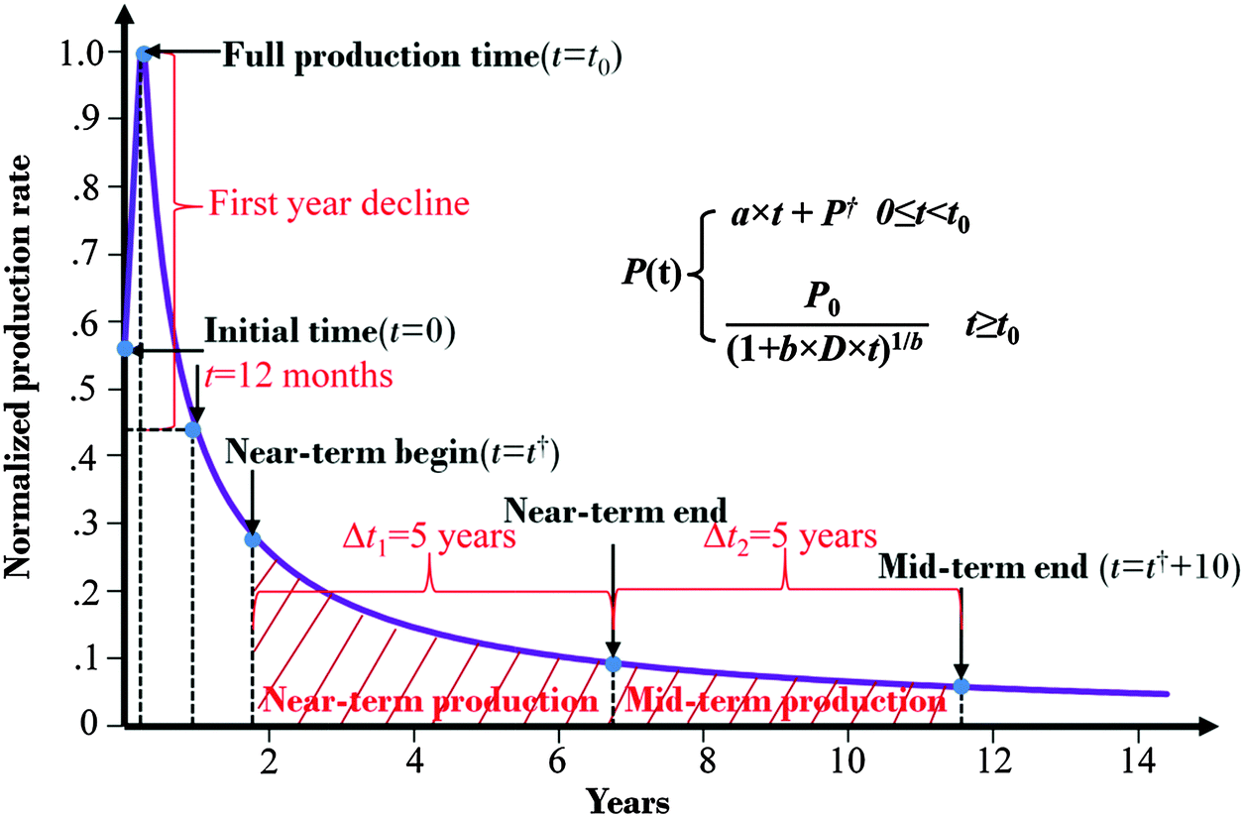
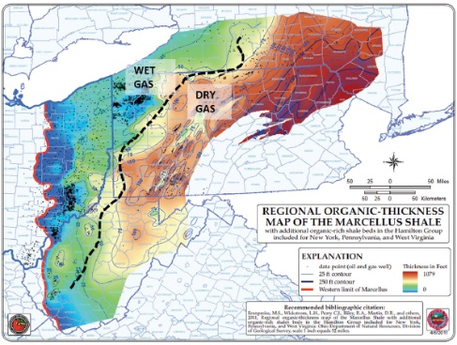
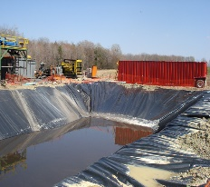
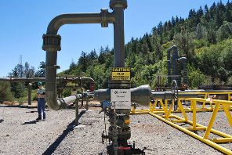

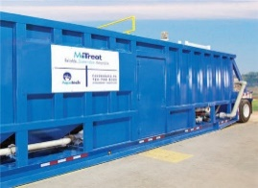

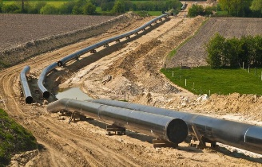
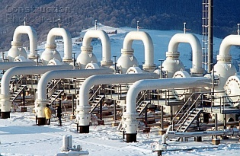
Leader’s Major Decisions
Drilling schedule
(where, when and how many to drill)
Decreasing production
Variant composition
Water management
Injection disposal
CWT
Onsite treatment
Gathering pipeline
Construction of gathering pipelines and compressor stations from shale sites to processing plants

Slide 11


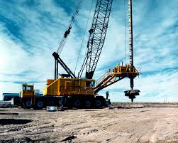
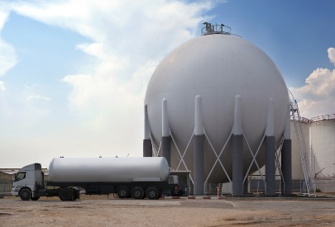

Problem Statement: Follower’s Problem
Given
Leader’s decisions
Candidate sites
Technology options
Unit cost and emission data
……
Determine
Selection of technology
Production profile
Transportation flow
……
Objectives
Max: Follower’s own profit
Partial information of this supply chain, including the leader’s decisions being made
Decisions only determined by the follower for part of the supply chain under its control
Notes:
The

Slide 12

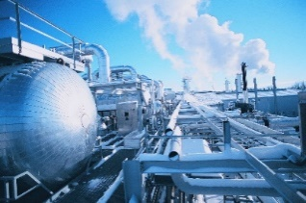
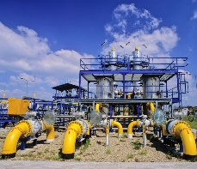

Follower’s Major Decisions
3 NGL recovery processes*:
The gas sub-cooled process (GSP)
The recycle split-vapor process (RSV)
Locations
The enhanced NGL recovery process (IPSI-1)
Process technologies
Transmission
Contract
Notes:
Under a fee-based contract, processors receive a fee based on how much gas they process. Under this type of contract, the processor does not have any direct sensitivity to commodity prices since revenues are linked to volume and not prices.
Under percentage of proceeds (POP) contracts, processors receive an agreed upon percentage of the actual proceeds of the sale of the dry natural gas and NGLs. Under this contract, the higher the price of natural gas and NGLs, the stronger the processors margins will be.
Under keep-whole contracts, the processor retains the NGLs extracted and returns the processed natural gas or value of the natural gas to the producer. Under this contract, the processor benefits when the price of NGLs increases and the price of natural gas decreases.

Slide 13
Follower’s Major Decisions
3 Distinct Processing Contracts:
Fee-based contracts (FB)
Processor receives a fixed fee for processing gas
Producer keeps all the gas and NGLs
Processor has no direct commodity exposure
Locations
Percentage of proceeds contracts (POP)
Process technologies
Processor receives an agreed upon percentage of the proceeds from sales of the gas and NGLs
Processor is 100% exposed to commodity risk
Transmission
Keep-whole contracts (KW)
Processor retains NGLs extracted from “raw stream” in exchange for keeping producer whole on a Btu basis
Processor gets mix of commodity exposure
Contract
Notes:
Under a fee-based contract, processors receive a fee based on how much gas they process. Under this type of contract, the processor does not have any direct sensitivity to commodity prices since revenues are linked to volume and not prices.
Under percentage of proceeds (POP) contracts, processors receive an agreed upon percentage of the actual proceeds of the sale of the dry natural gas and NGLs. Under this contract, the higher the price of natural gas and NGLs, the stronger the processors margins will be.
Under keep-whole contracts, the processor retains the NGLs extracted and returns the processed natural gas or value of the natural gas to the producer. Under this contract, the processor benefits when the price of NGLs increases and the price of natural gas decreases.

Slide 14
General MIBLP Model Formulation
Multi-objective mixed-integer bilevel linear program (MIBLP):
Leader’s Economic Objective
Leader’s Environmental Objective
Mass balance constraints
Economic analysis constraints
Capacity constraints
Logic constraints
Life cycle environmental Impact
……
Follower’s Economic Objective
Mass balance constraints
Economic analysis constraints
Capacity constraints
Logic constraints
……

Slide 15
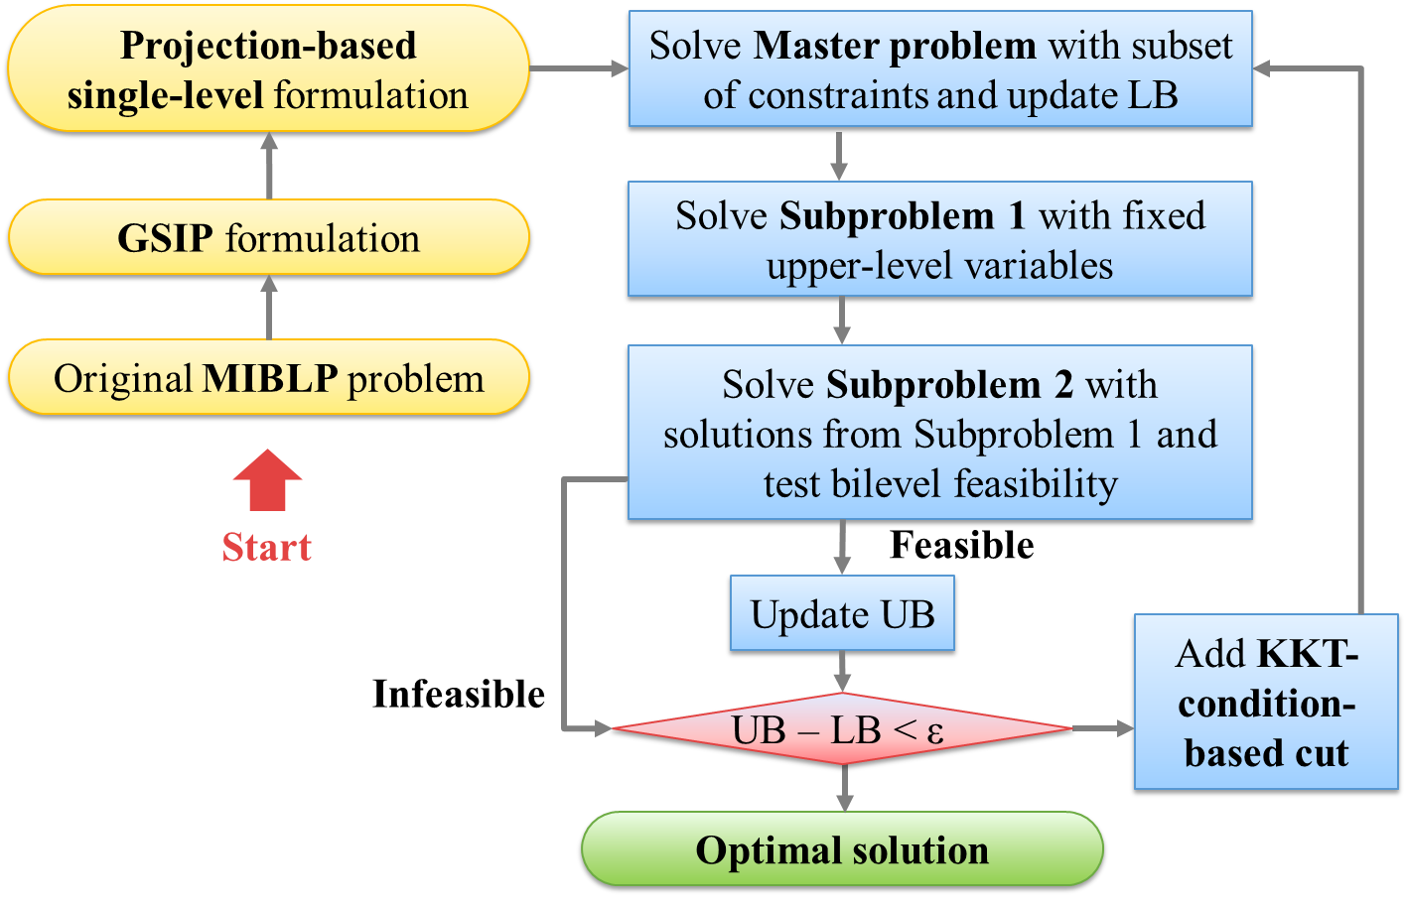
Solution Algorithm
Reformulation
Decomposition
Yue, D.; You, F. A Projection-Based Reformulation and Decomposition Algorithm for Optimization of a Class of Mixed Integer Bilevel Linear Programs. Journal of Global Optimization, (submitted).

Slide 16
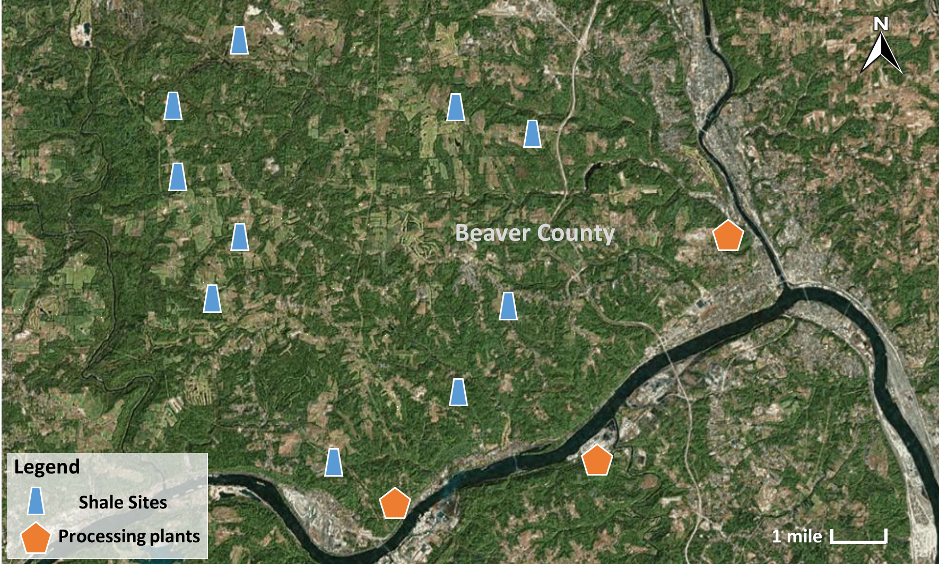
Case Study
10 shale sites (up to 4-8 shale wells each site)
3 processing plants
10 year planning horizon

Slide 17
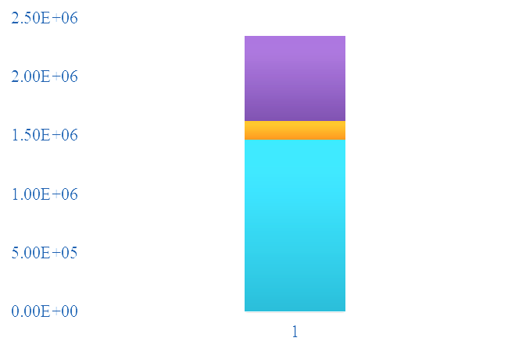
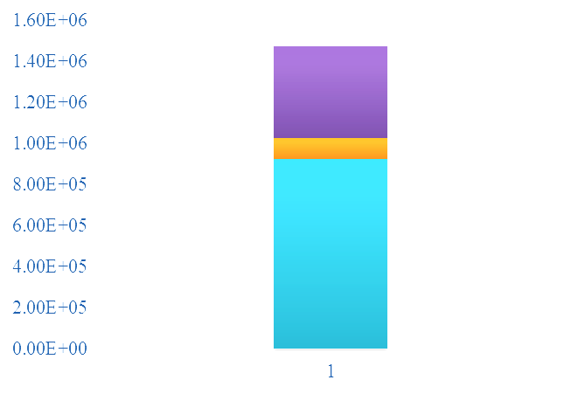
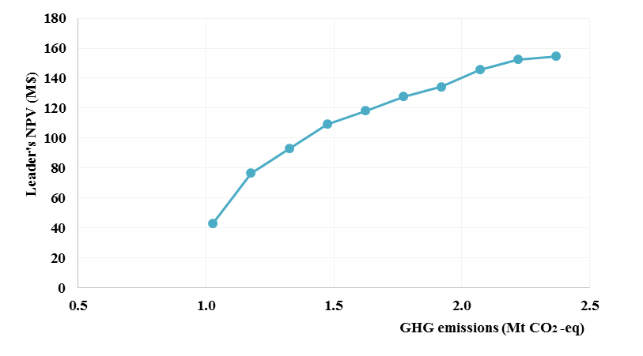

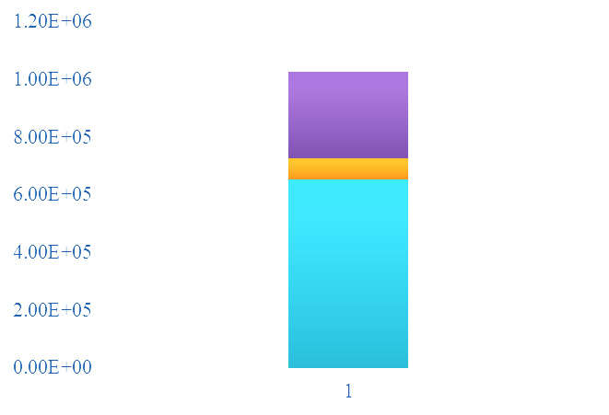
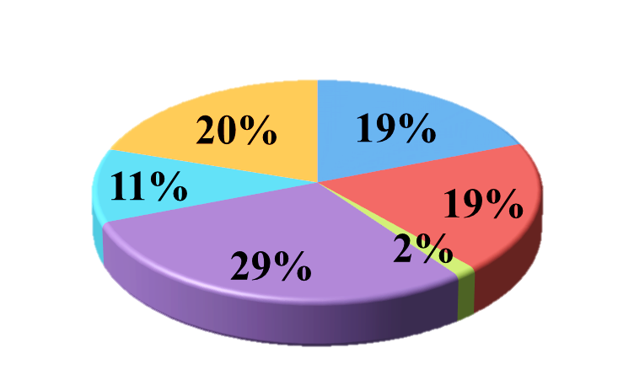
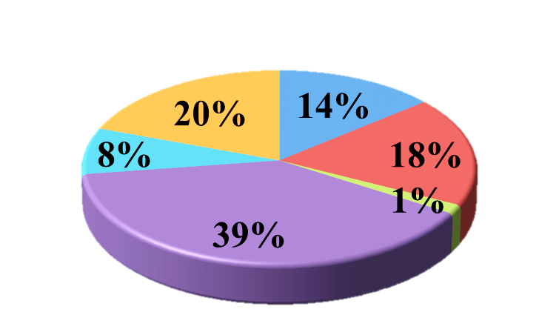
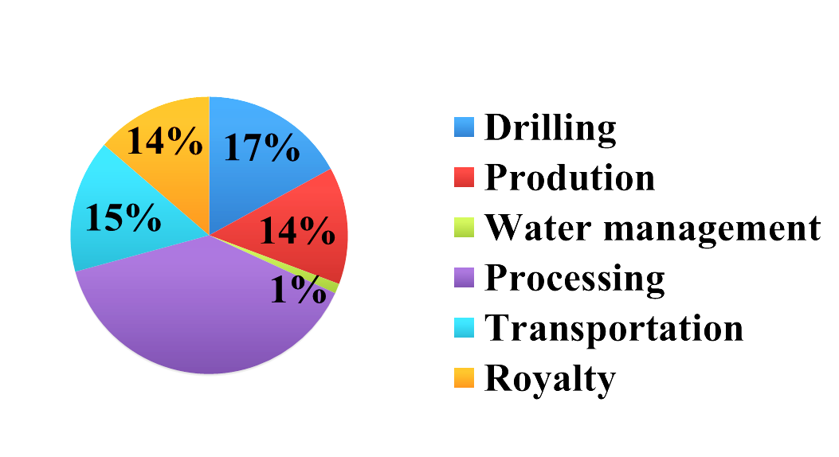

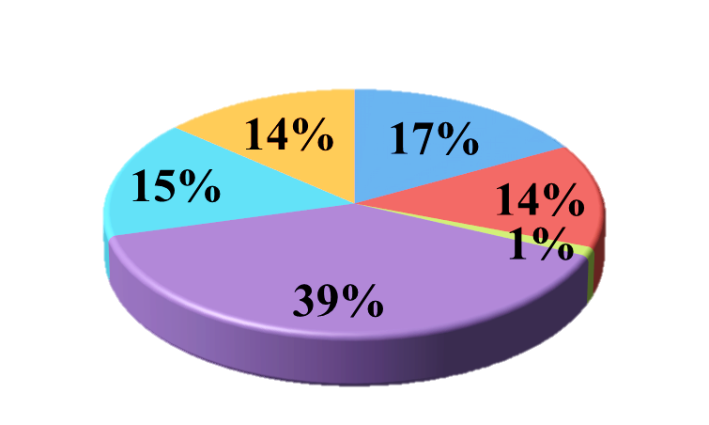
Leader’s Cost vs. Total Emission
Emissions breakdowns
62%
7%
31%
Processing
Transportation
B
Production
63%
7%
30%
C
64%
7%
29%
Cost breakdowns
A

Slide 18
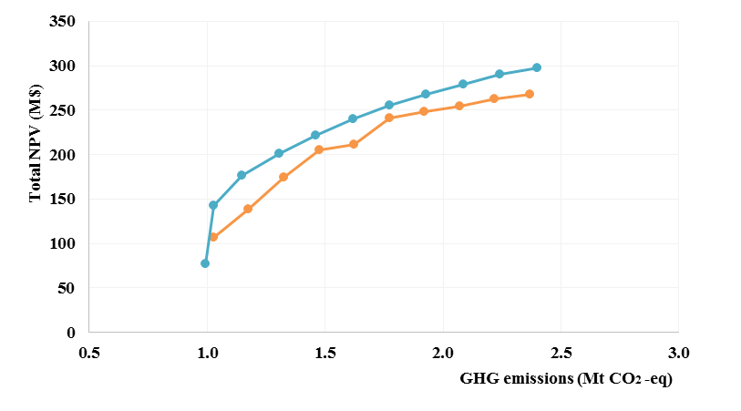
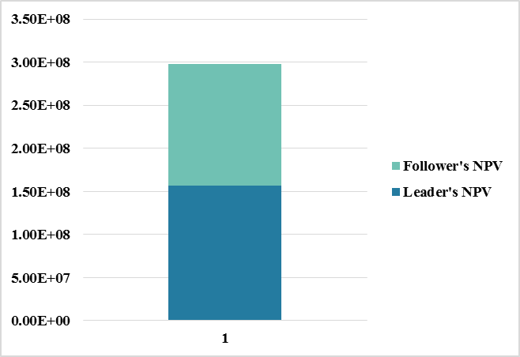
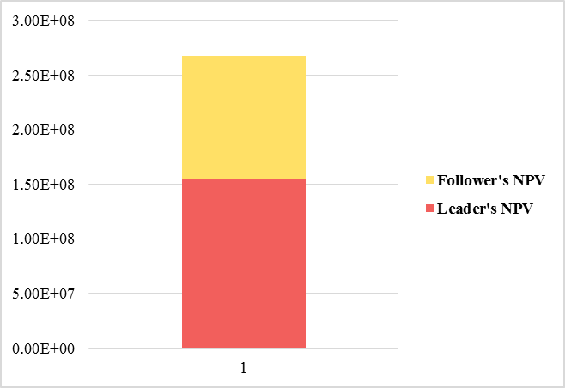

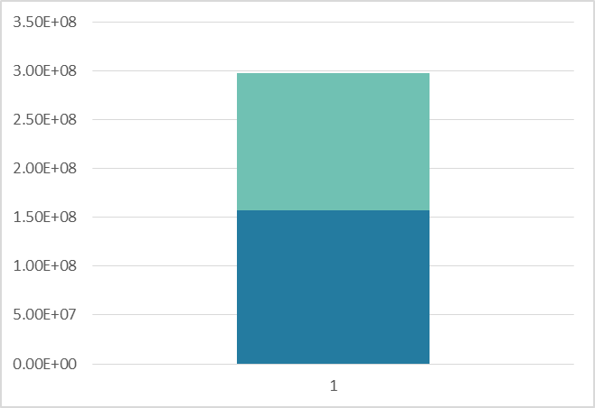
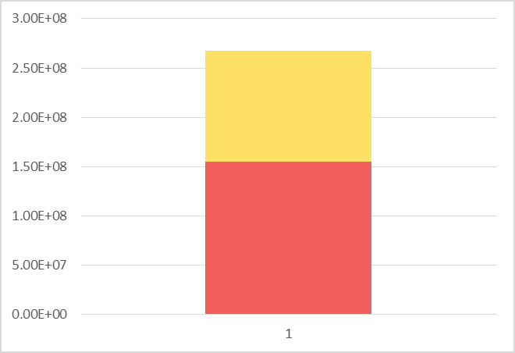
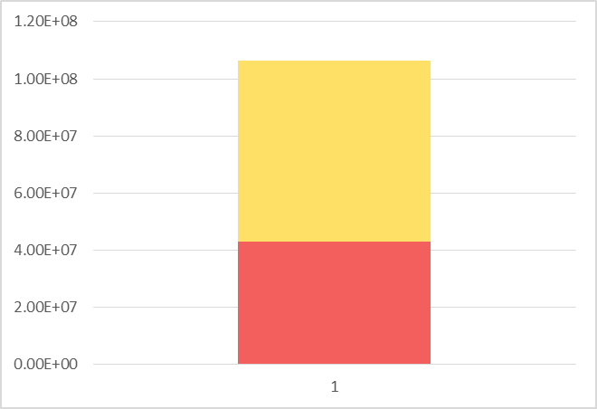
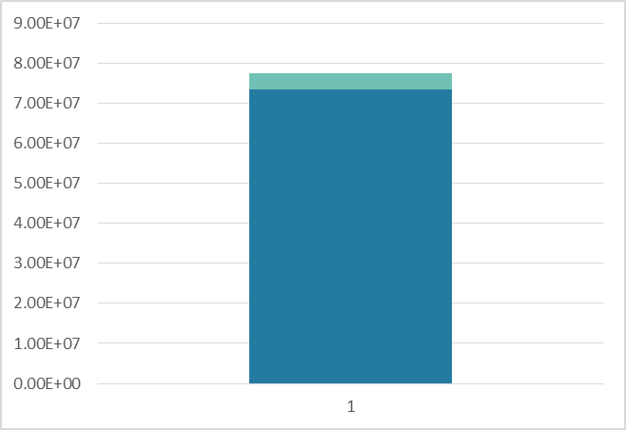
Comparison between GT Model vs. CT Model
Centralized model:
Game theory model:
+10.2%
Centralized model
max total NPV
47.3%
42.2%
Game theory model
5.2%
52.7%
59.6%
57.8%
94.8%
-3.4%
40.4%

Slide 19
Comparison between GT Model vs. CL Model
Leader centralized model (max leader’s NPV):
Leader’s NPV
+54.2%
Game theory model:
Leader’s NPV
Follower’s NPV
+100.7%
Leader centralized model (max leader’s NPV):
Follower’s NPV

Slide 20
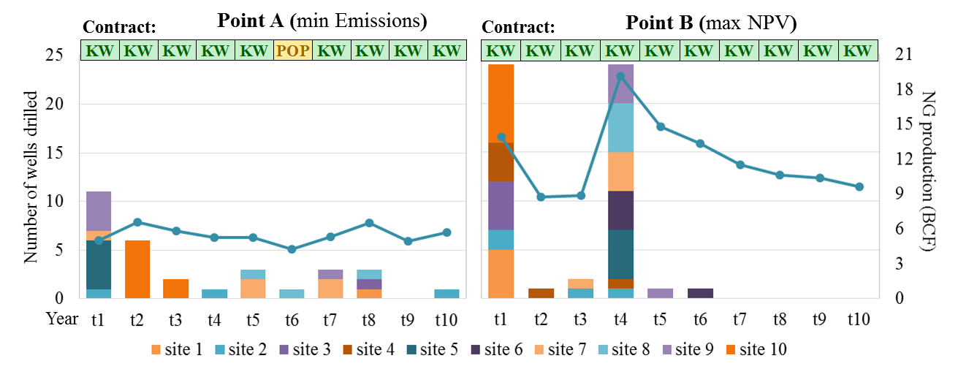



Drilling Schedules and Production Profiles

Slide 21


Water Management Strategies
min Emission
max NPV

Slide 22

Computational Results
 | # of Int. Var | # of Cont. Var | # of Constraints | CPU Time (s)
Master Problem | 266-3,485 | 3,937-13,533 | 1,062-10,949 | 10.4-3,379.5
Subproblem 1 | 126 | 3,056 | 531 | 0.5-0.9
Subproblem 2 | 126 | 3,057 | 543 | 0.6-0.3

Slide 23
Conclusions
General modeling framework for optimization of non-cooperative shale gas supply chains considering economics and life cycle GHG emissions
Case study on Marcellus shale play
Comprehensive comparison between centralized and game theory-based models

Slide 24


End
Thank you!
Any questions?
www.peese.org

